Slide 1
Operated by Los Alamos National Security, LLC,
for the U.S. Department of Energy
EEX-based Beam Compression
with Higher-Order Corrections
Kip Bishofberger, Bruce Carlsten,
Steve Russell, Nikolai Yampolsky
Los Alamos National Laboratory
Notes:
1
MaRIE = Matter Radiation Interactions and Extremes, a la Ms. Curie

Slide 2
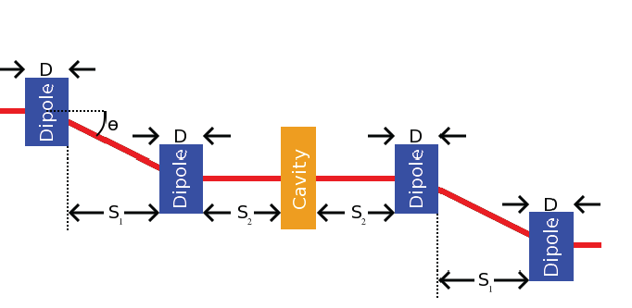
Introduction: EEX basics
  EEXs are excellent devices for swapping emittances between the longitudinal dimension and a transverse dimension.
  Zeroing out the block-diagonal elements requires correct adjustment of the cavity strength.
  Beyond that, multiple parameters can be adjusted to play with specific elements in the transfer matrix.
  In-situ, drift lengths can be adjusted through additional triplet pairs. This includes providing negative drifts, and eliminating “thick lens” effects of the cavity.
Notes:
2

Slide 3
Introduction: Compressor setup
  One EEX swaps x and z emittances. A second EEX swaps them back.
  In the meantime, the multitude of knobs provides a variety of beam-manipulation capability.
  In particular, two identical EEXs, with a transverse focusing telescope in between, can provide longitudinal beam compression, without any need for a chirp.
  This idea is similar to a design proposed by Zholents,Zolotorev (PAC11).
Notes:
3

Slide 4
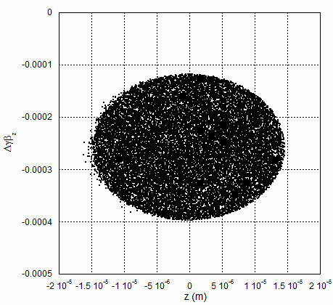
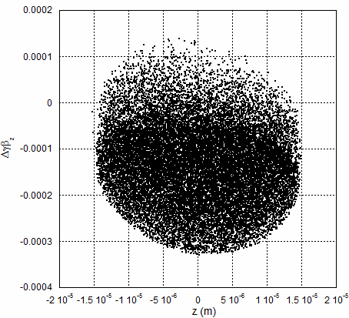
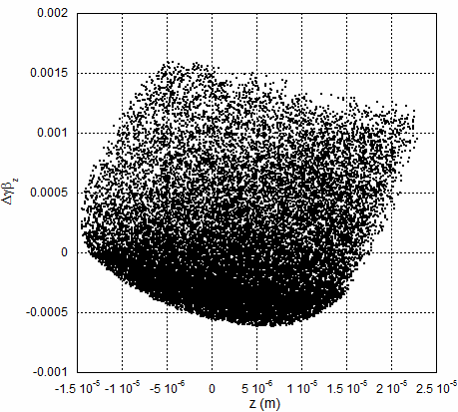
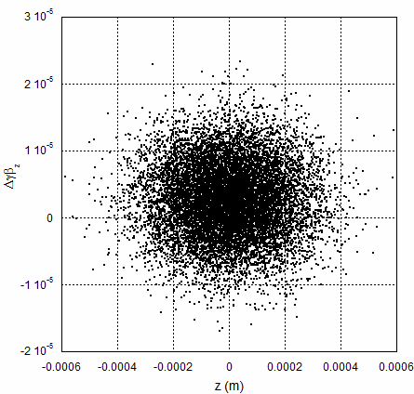
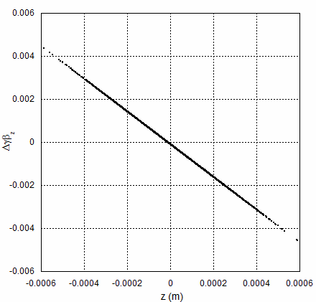
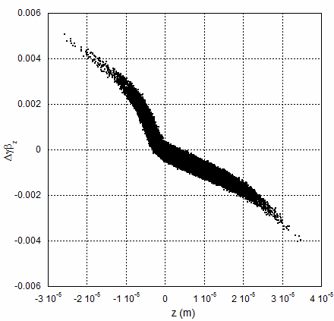
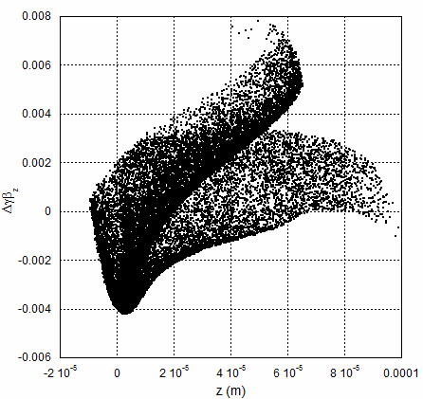
Introduction: EEX vs chicane approach
  EEX-based approach is superior to chicane-based approach:
    Avoids need to chirp; more tolerant to chirp fluctuations.
    Less CSR-induced nonlinearities
    Significantly more knobs to tailor specific needs (ie, more complex)
    Ability to remove high-order emittance spoilers.
0 pC
100 pC
1 nC
EEX compressor
(1 nC, 25 fsec, ~ 40 kA)
chicane
Notes:
4

Slide 5
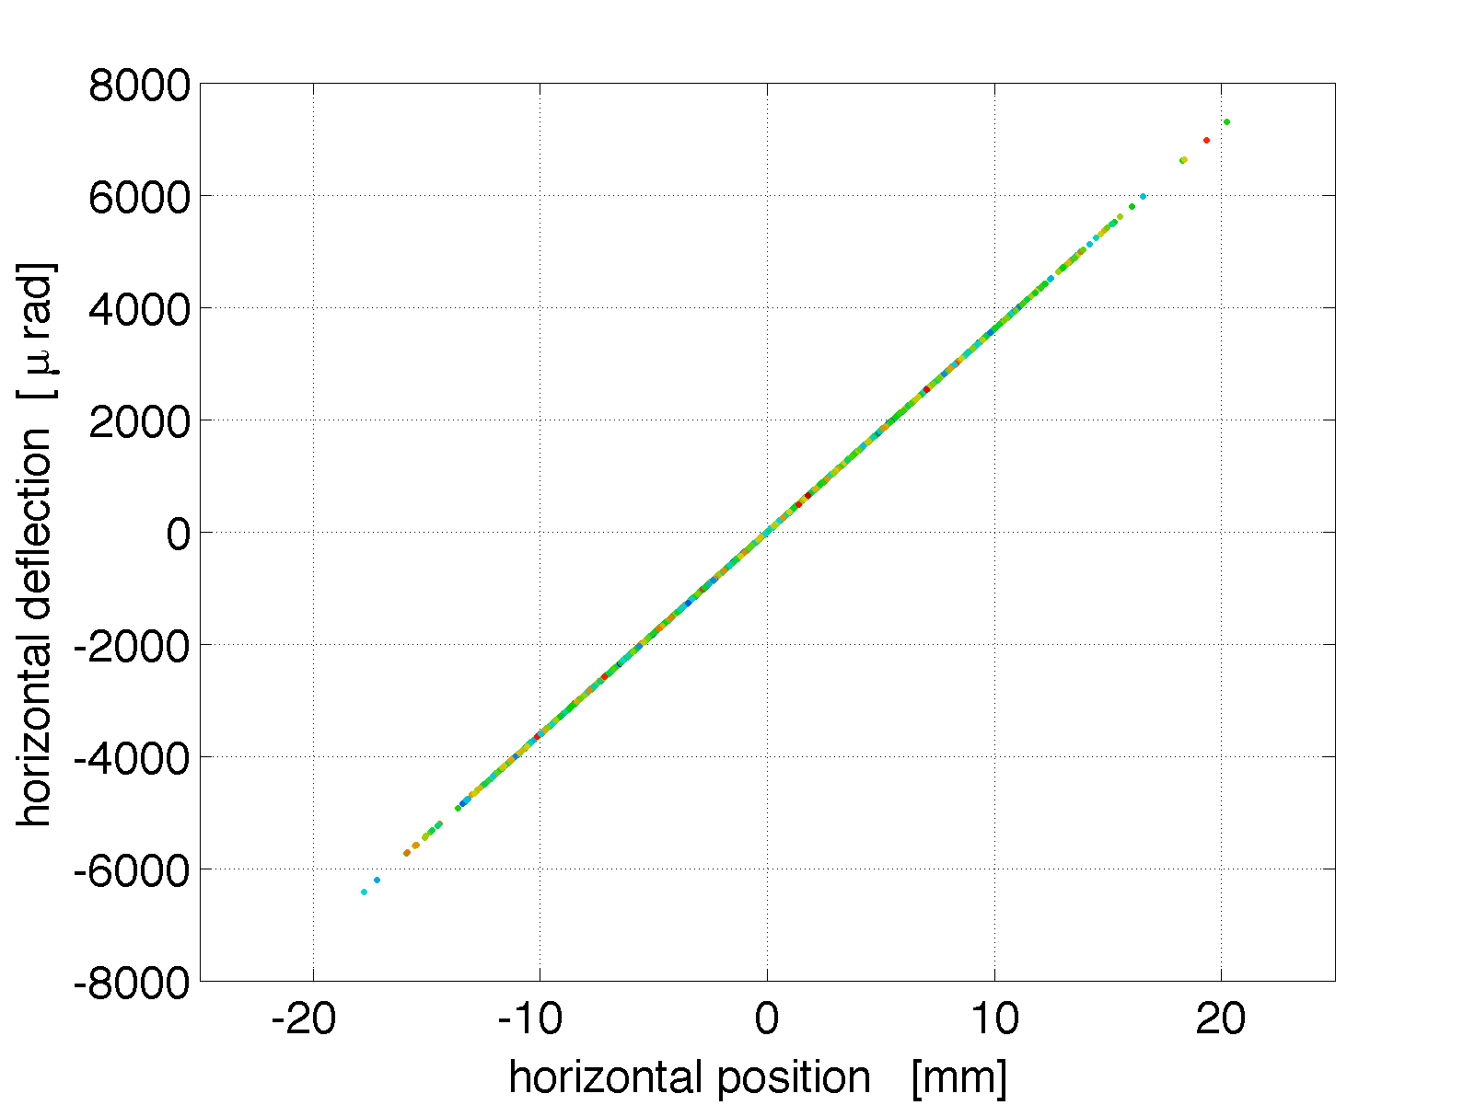
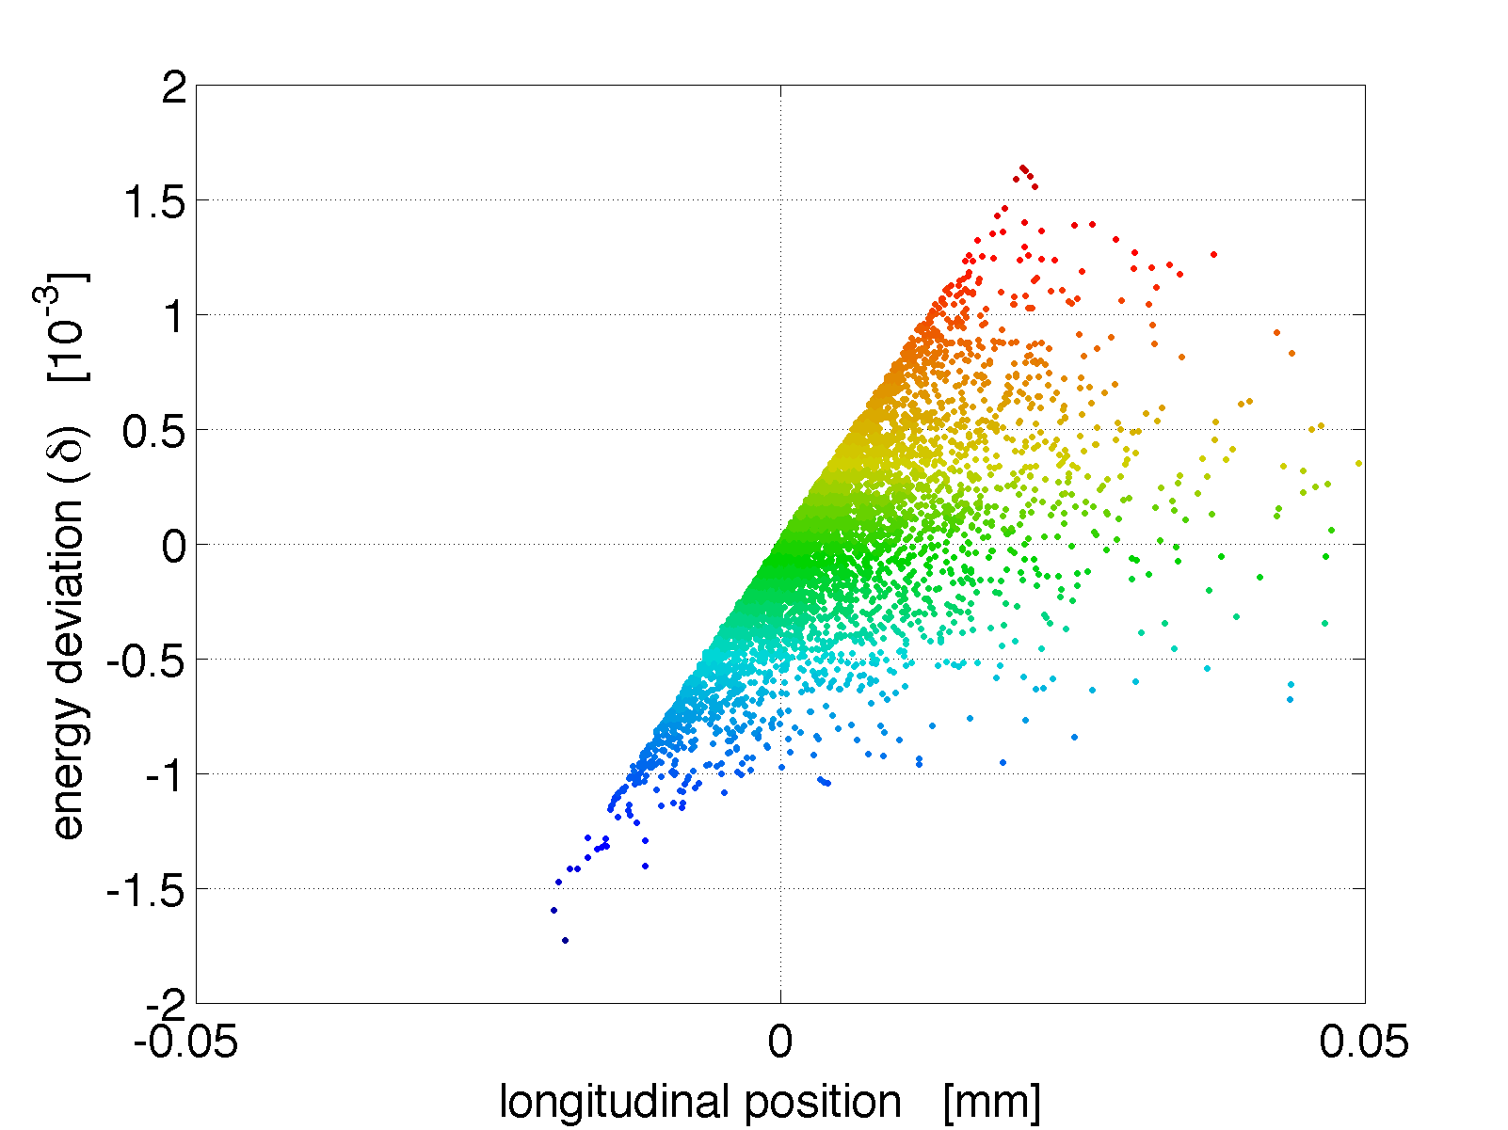
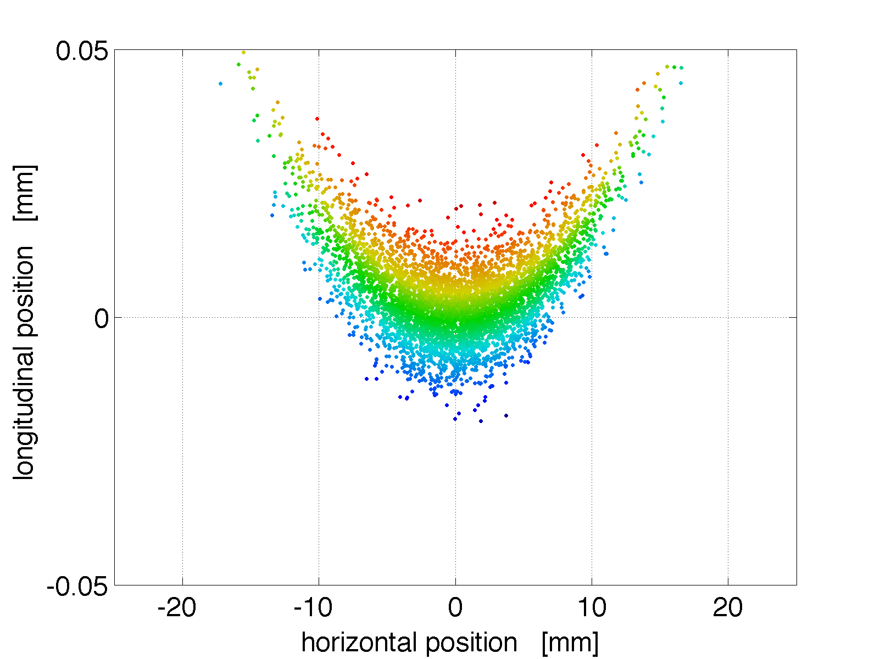
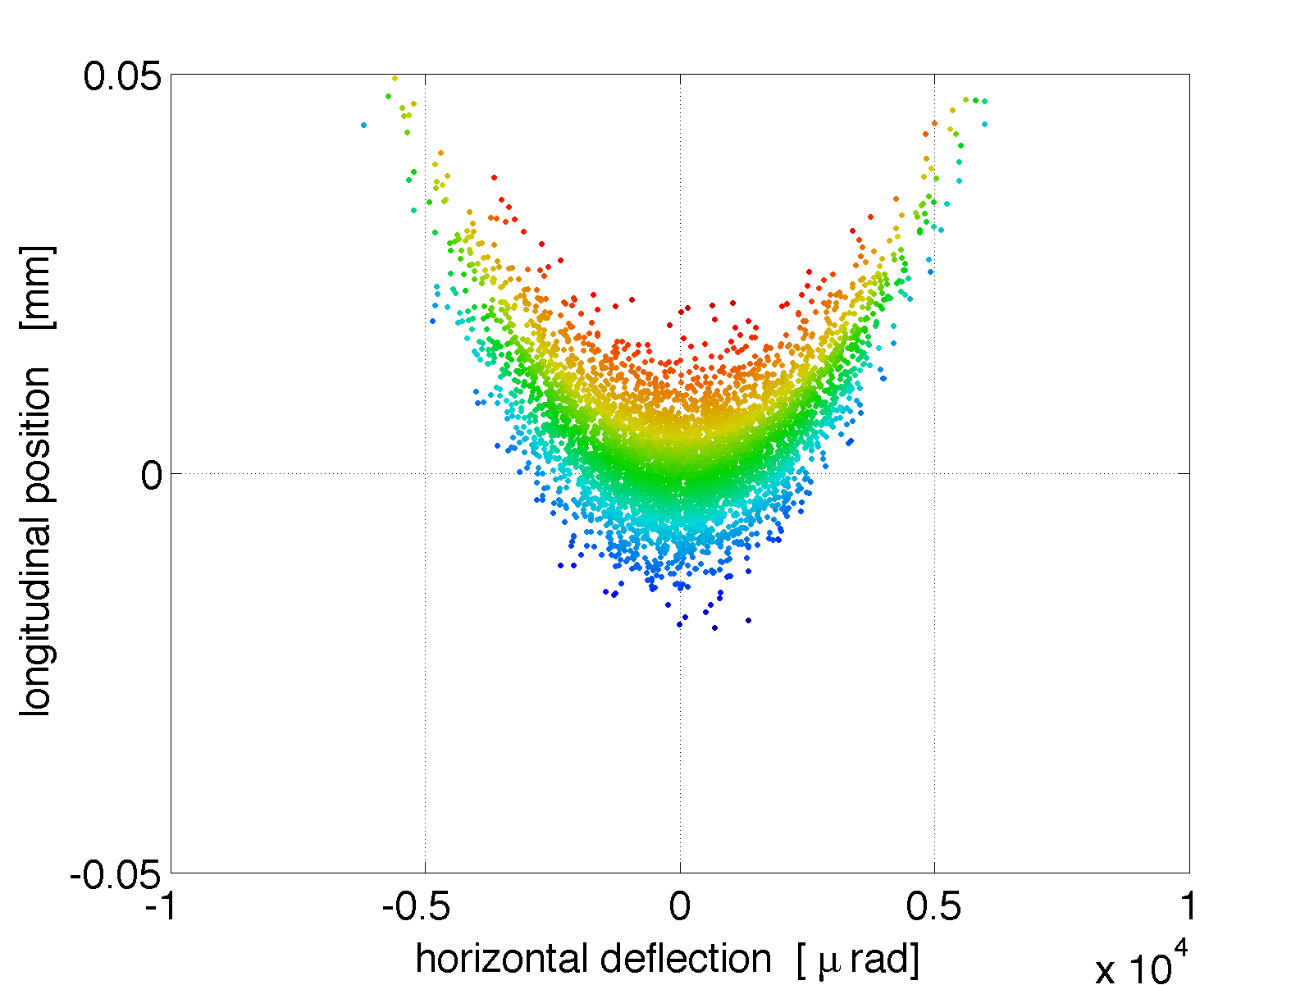
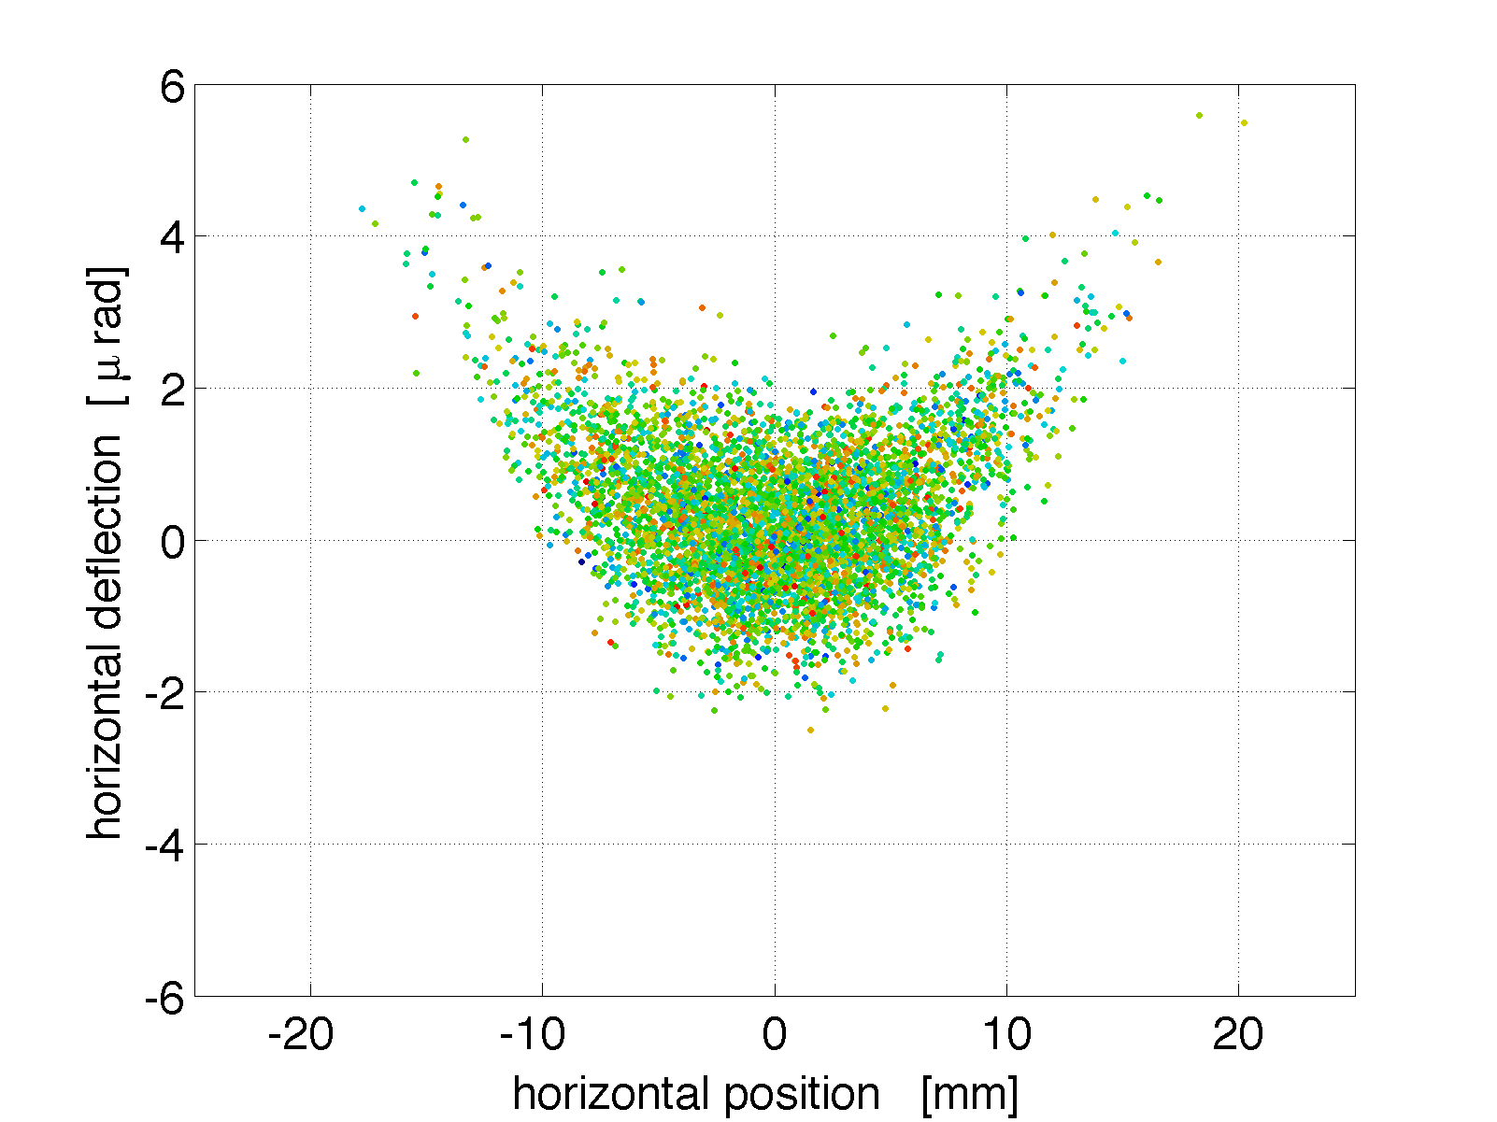
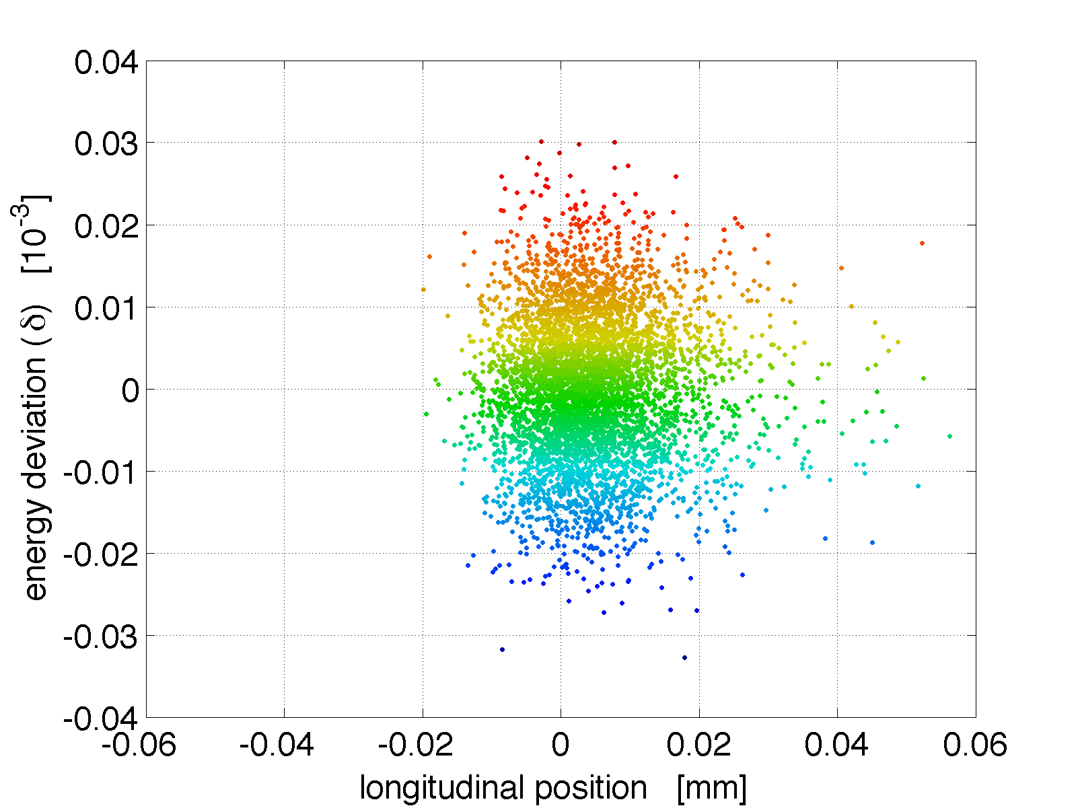
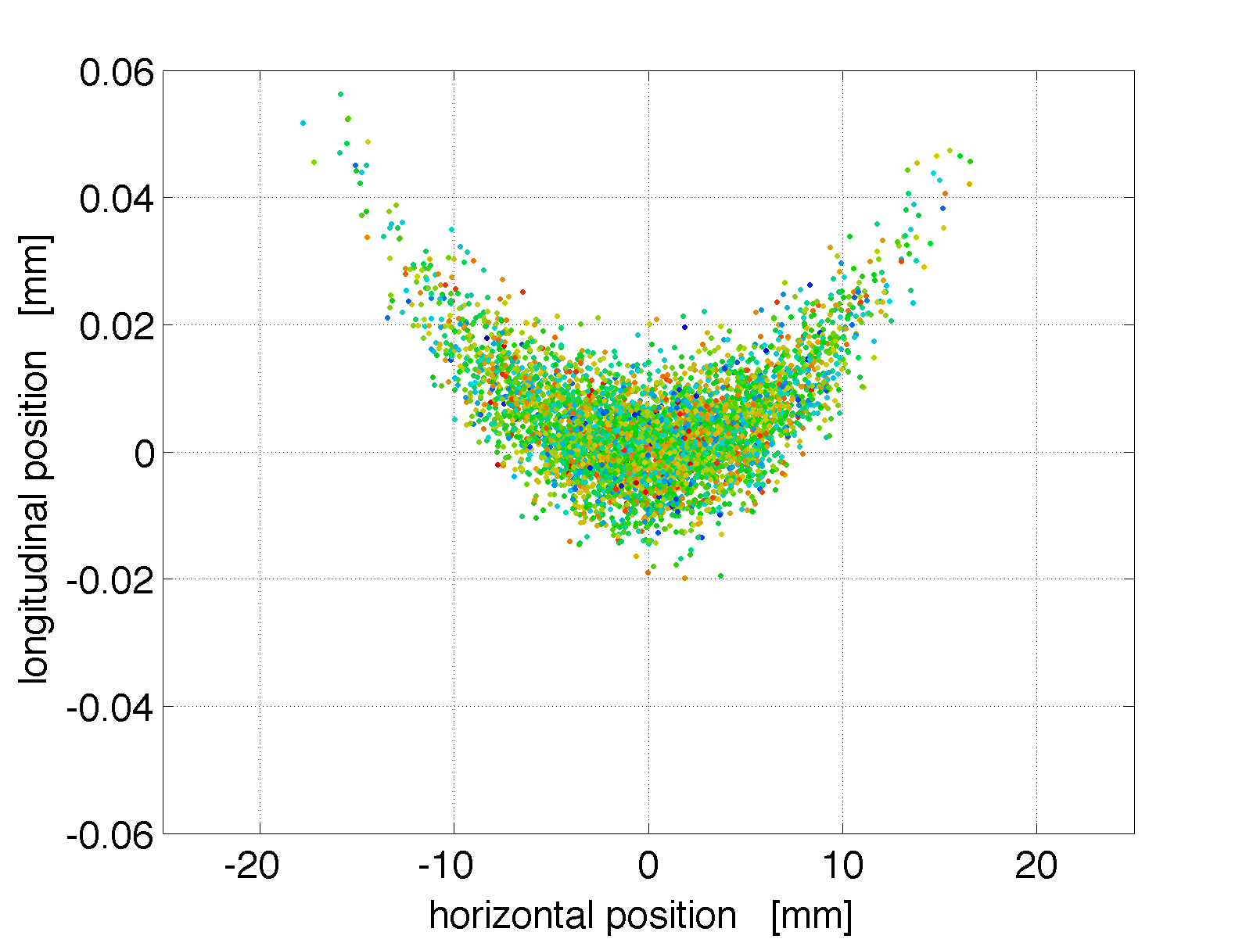
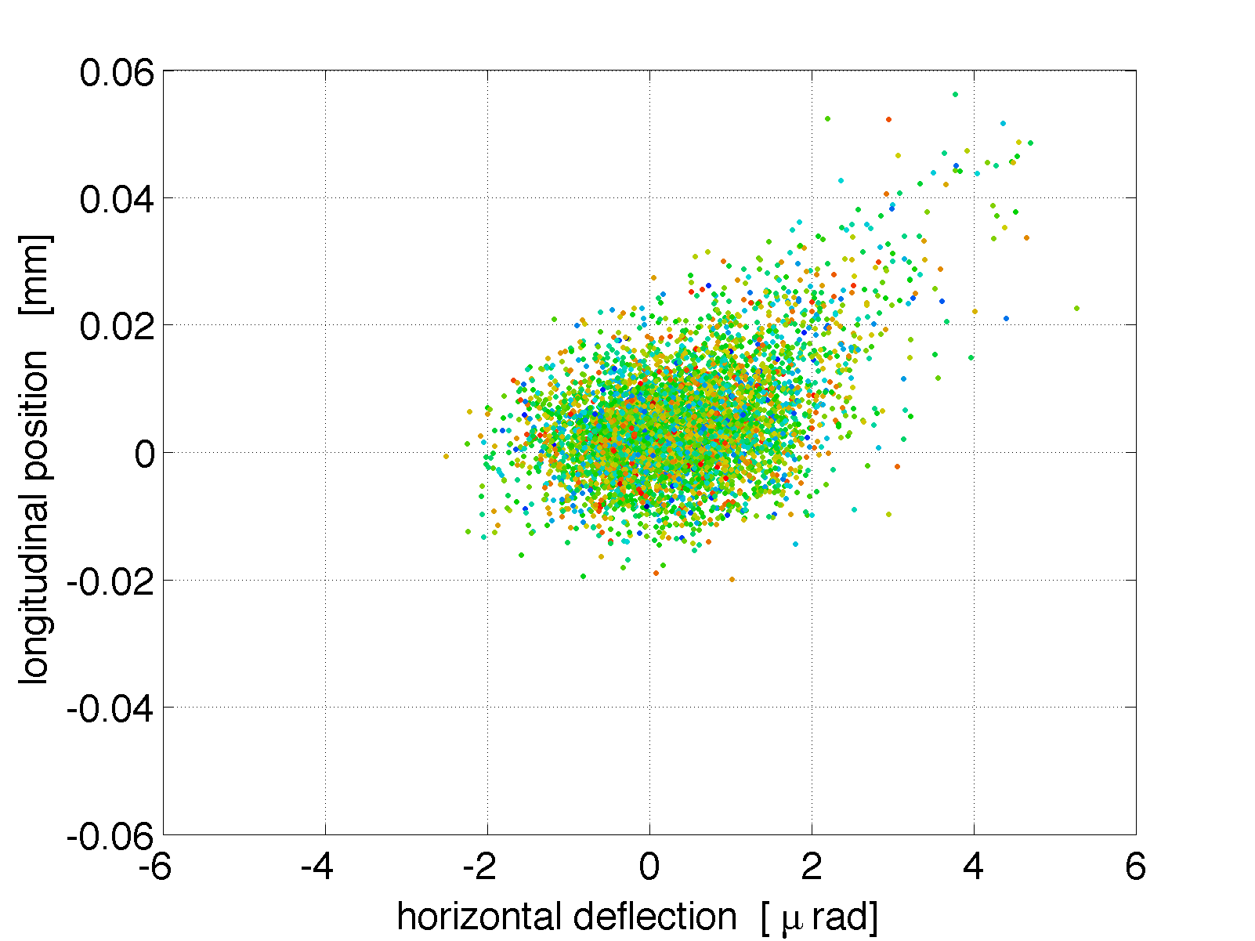
EEX linearization, page 1
sigma_i=[0.1 0.1 0.4001] mm, 10e-5
emitN_i=[0.1 0.1 7.8283]
(x vs x’)
(z vs ∂)
(x vs z)
(x’ vs ∂)
No correctors
+two quads: QA4,QB4
Notes:
5

Slide 6
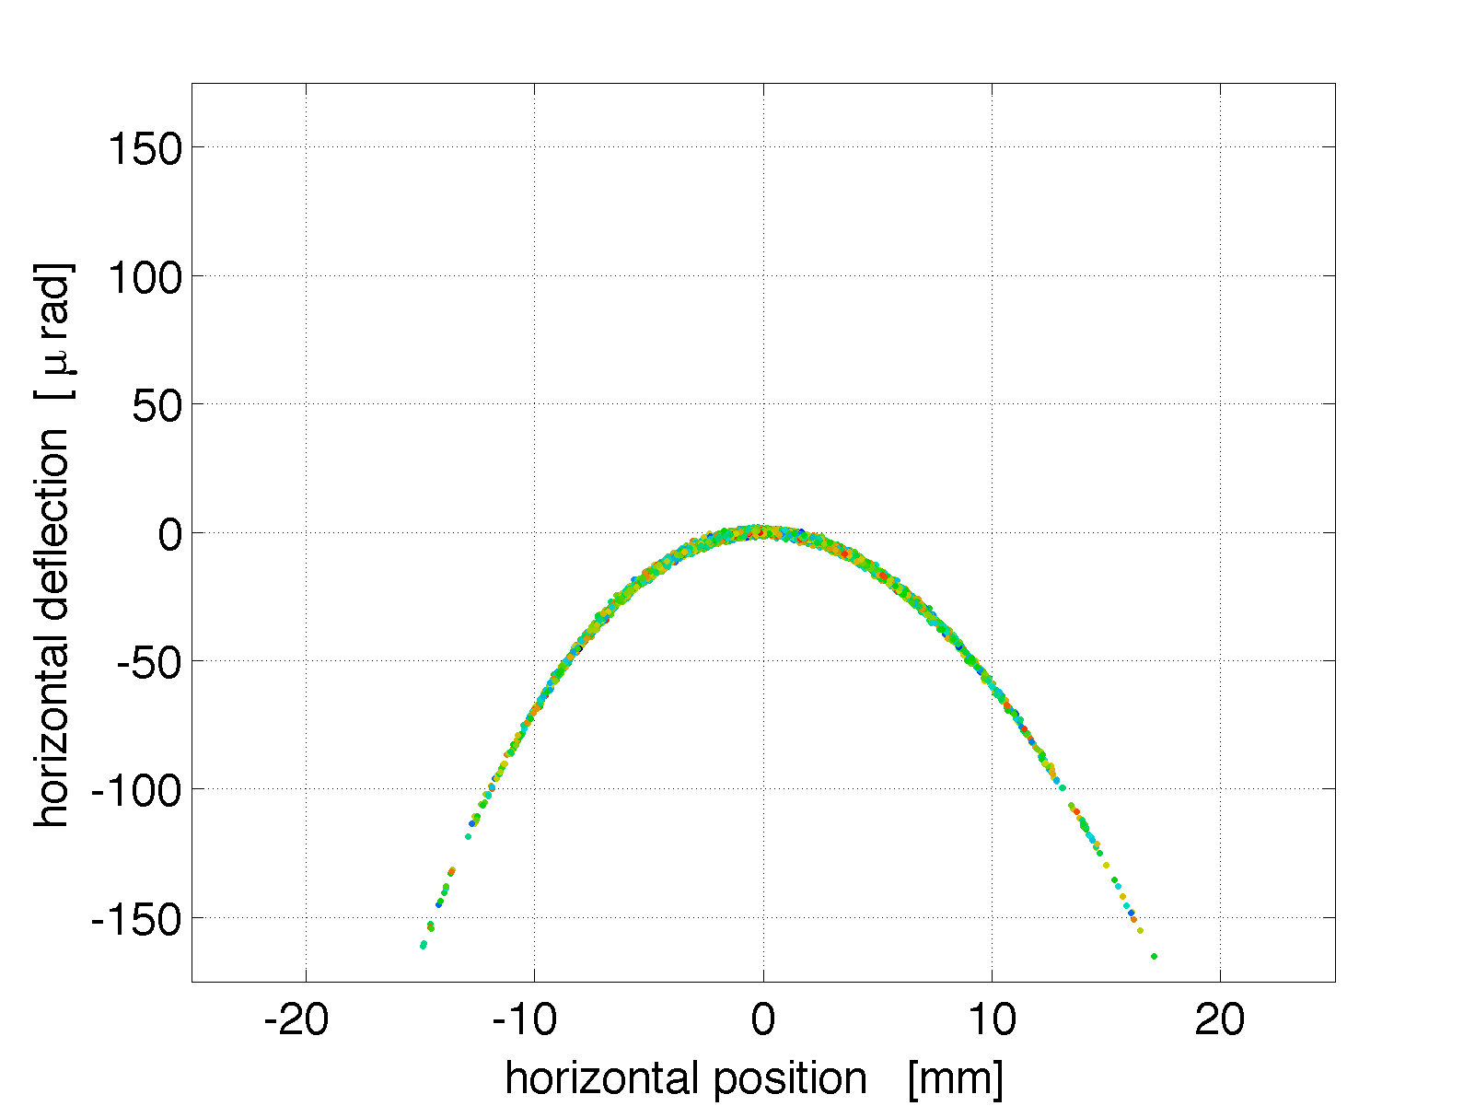
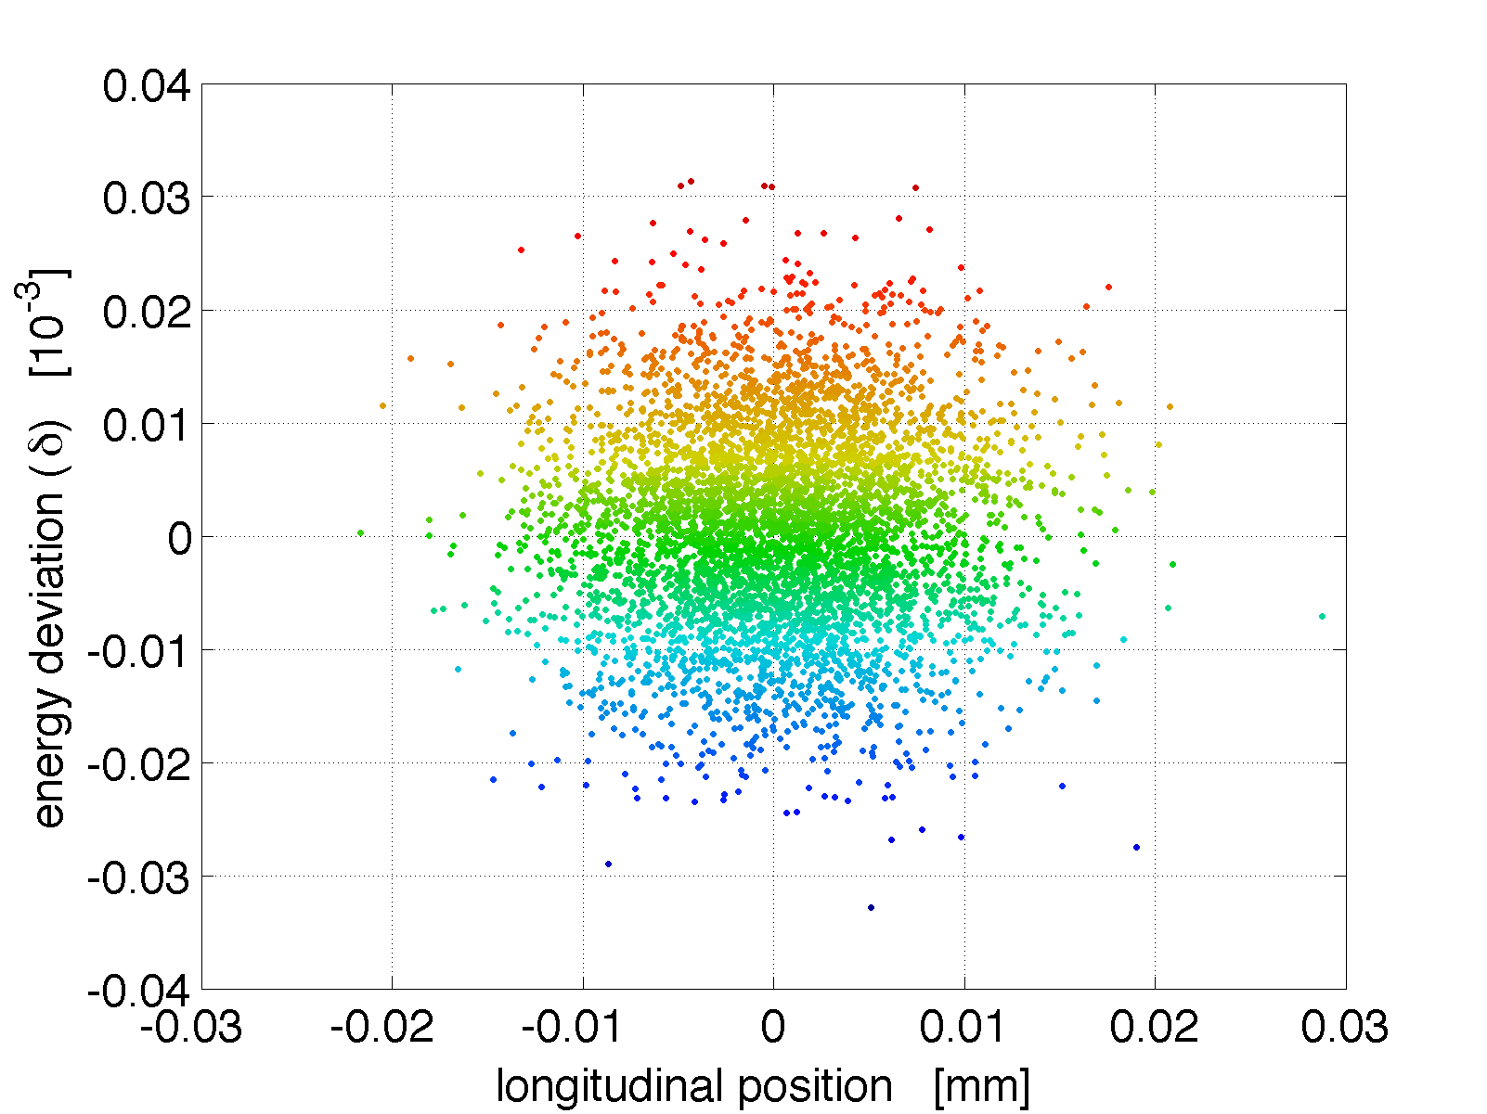
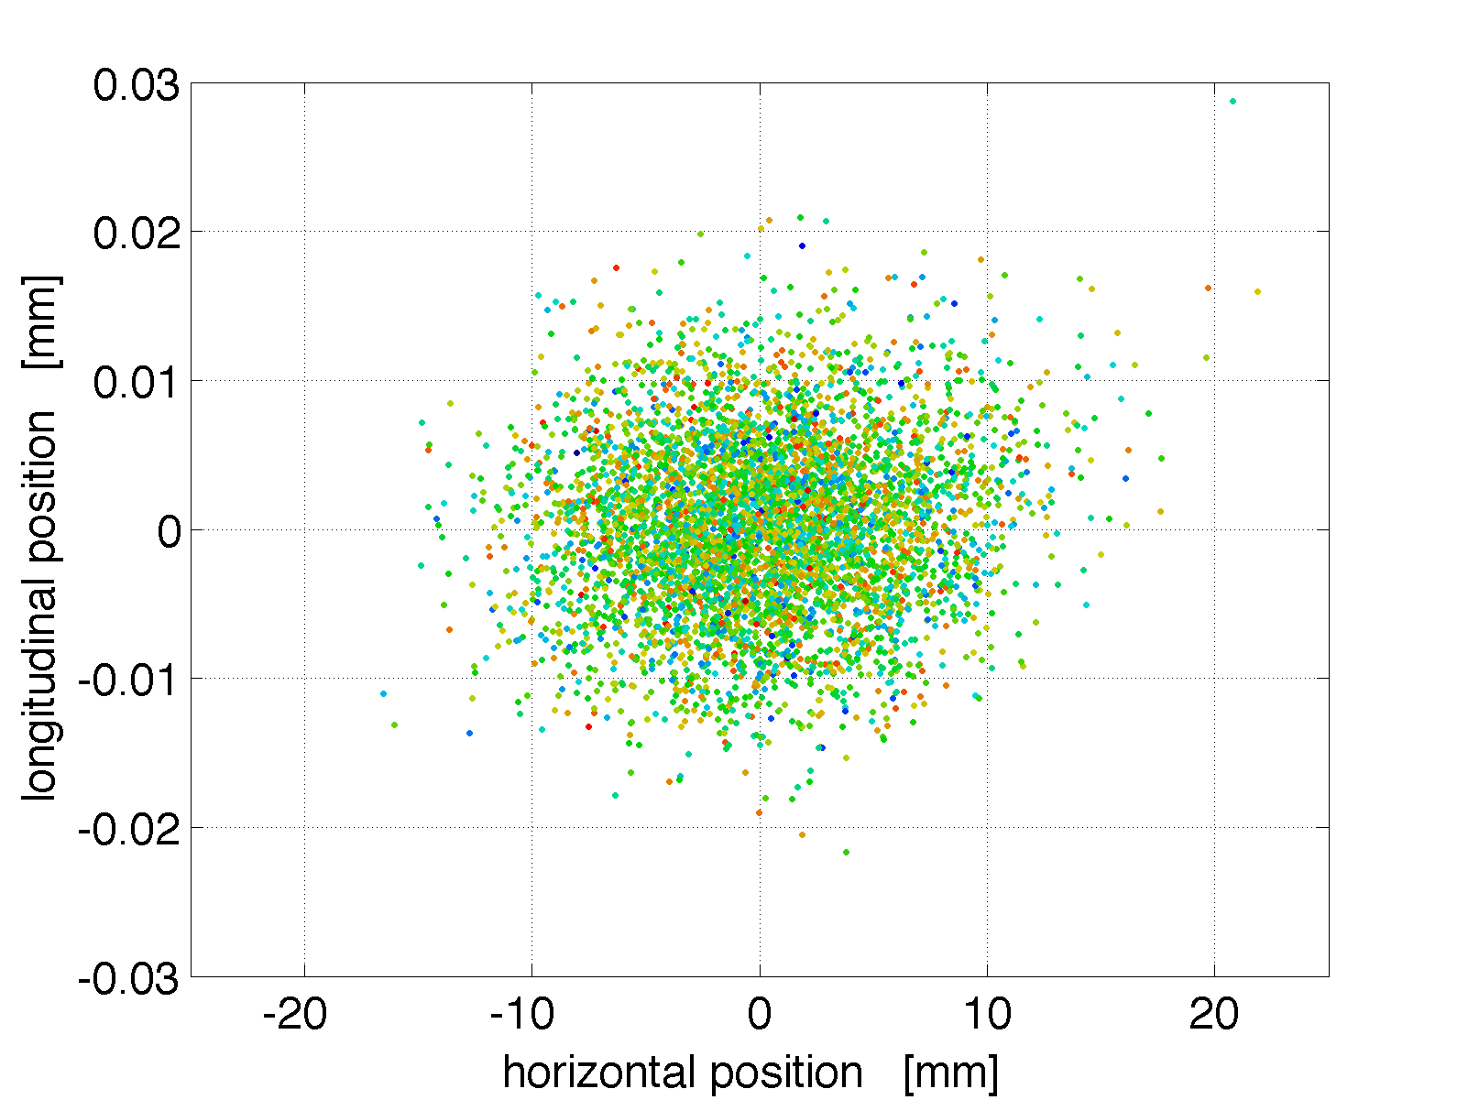
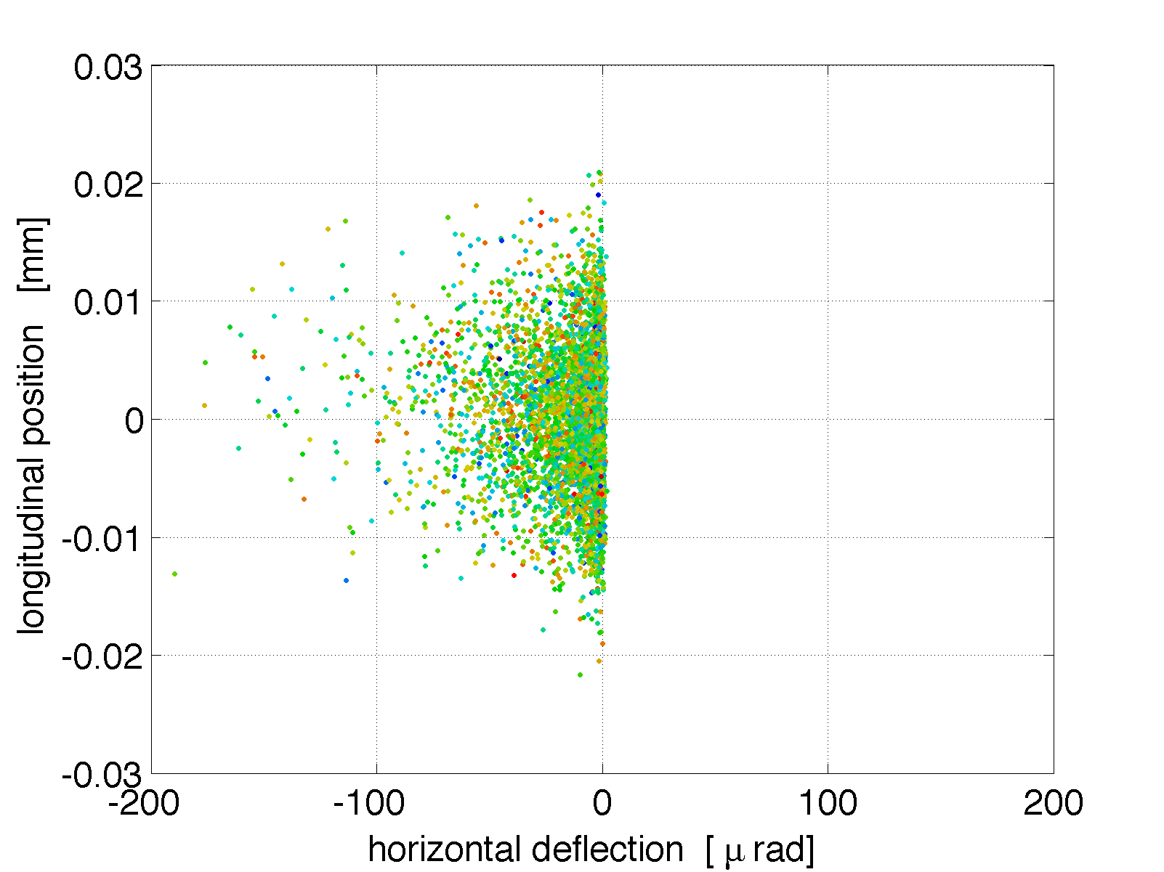
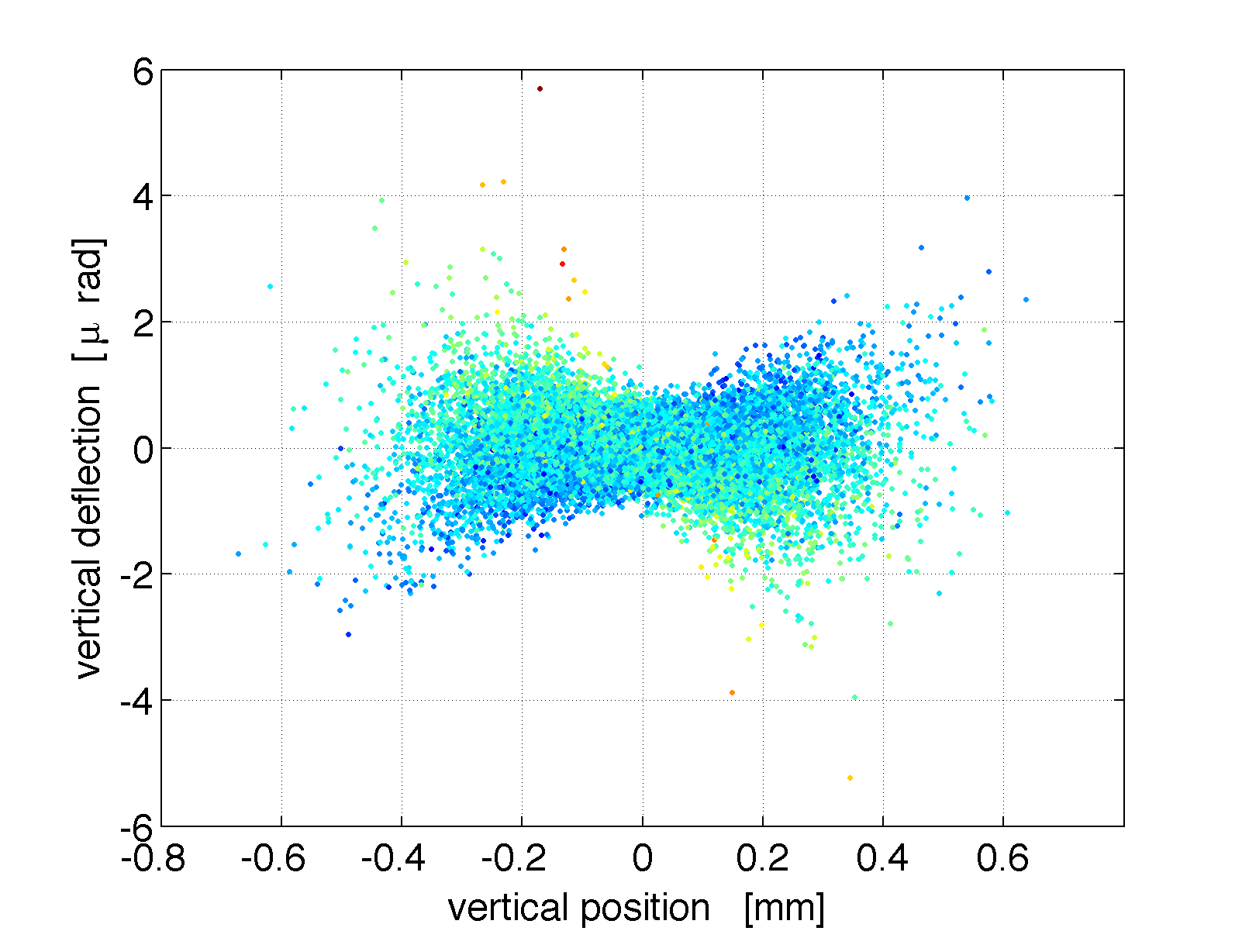
EEX linearization, page 2
+two mid-EEX sex’s: cor16
As expected, quads and sextupoles repair first and second-order correlations.
A cross-coupled second-order correlation (x,z) can be fixed through inter-EEX sextupoles, but force retuning.
However, the y-dimension, uncontrolled, generates severe path-length nonlinearities. Optimization strategies must maintain small beam sizes in y.
Notes:
6

Slide 7
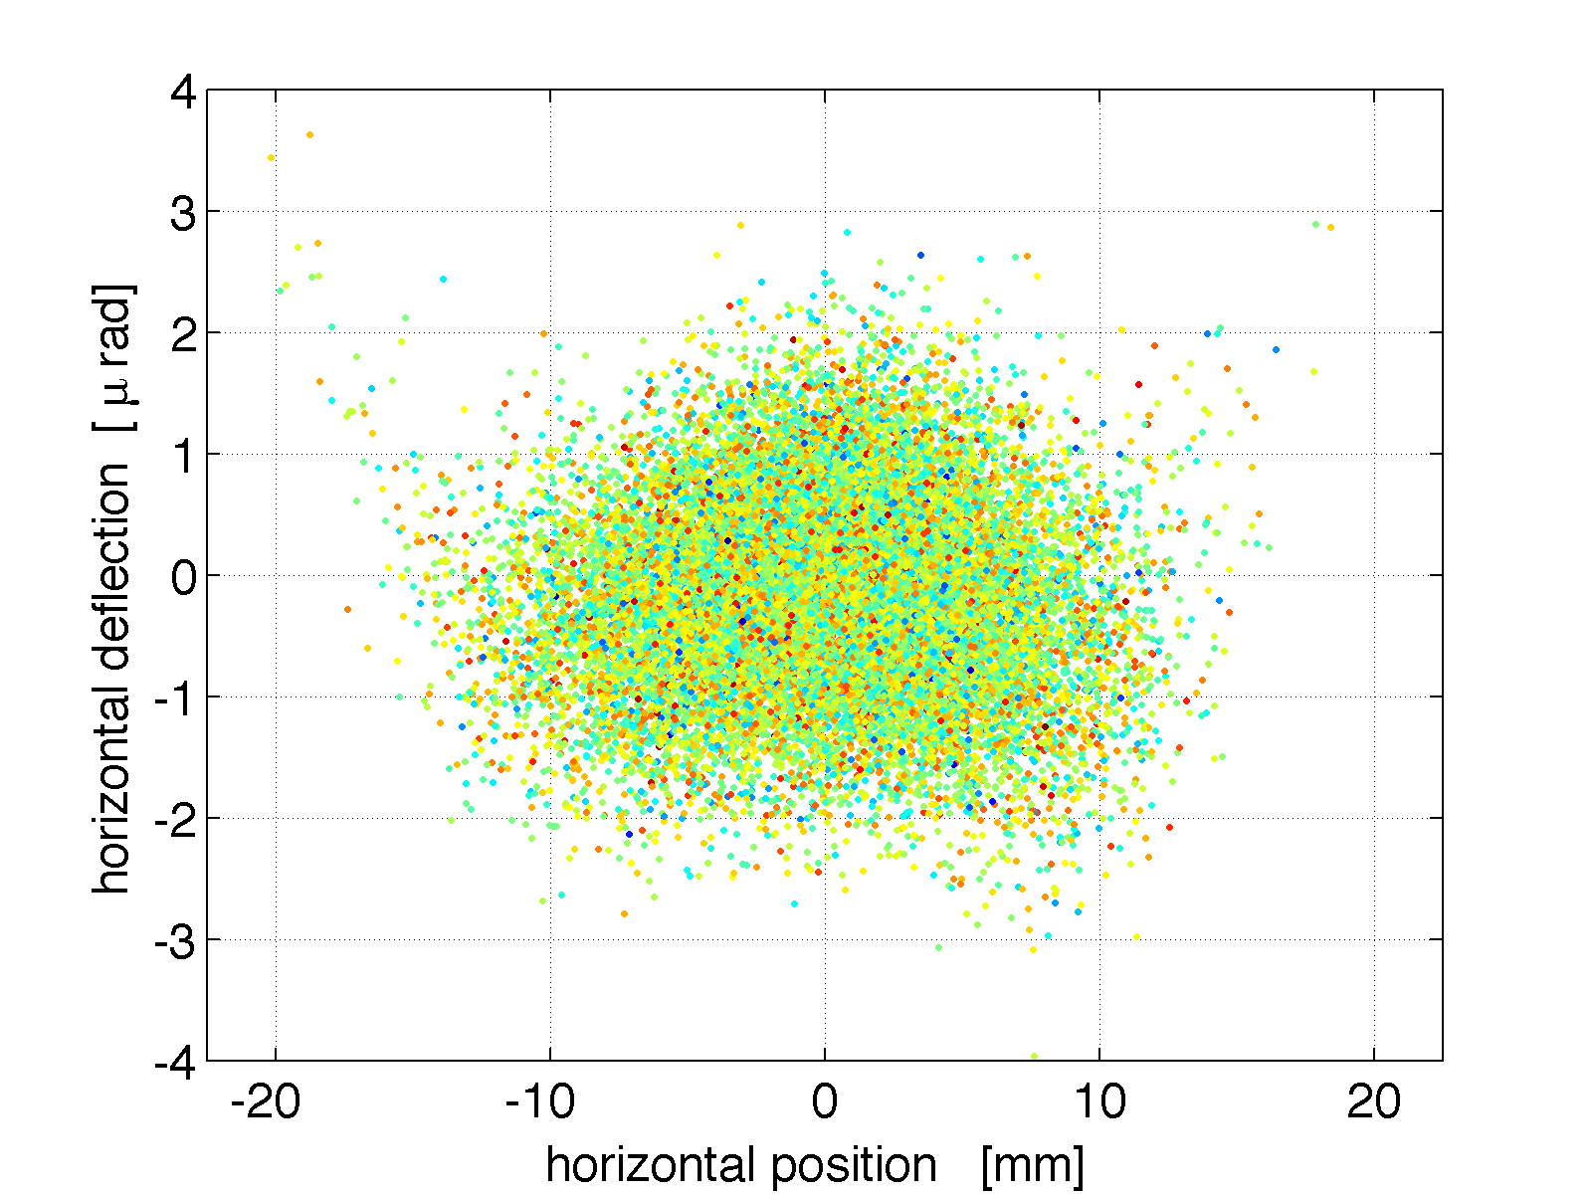
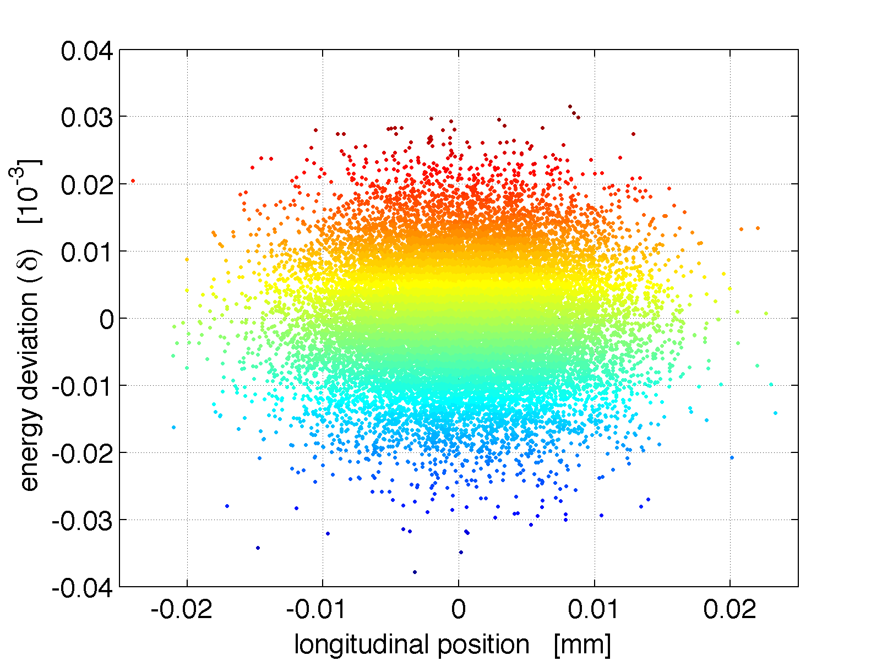
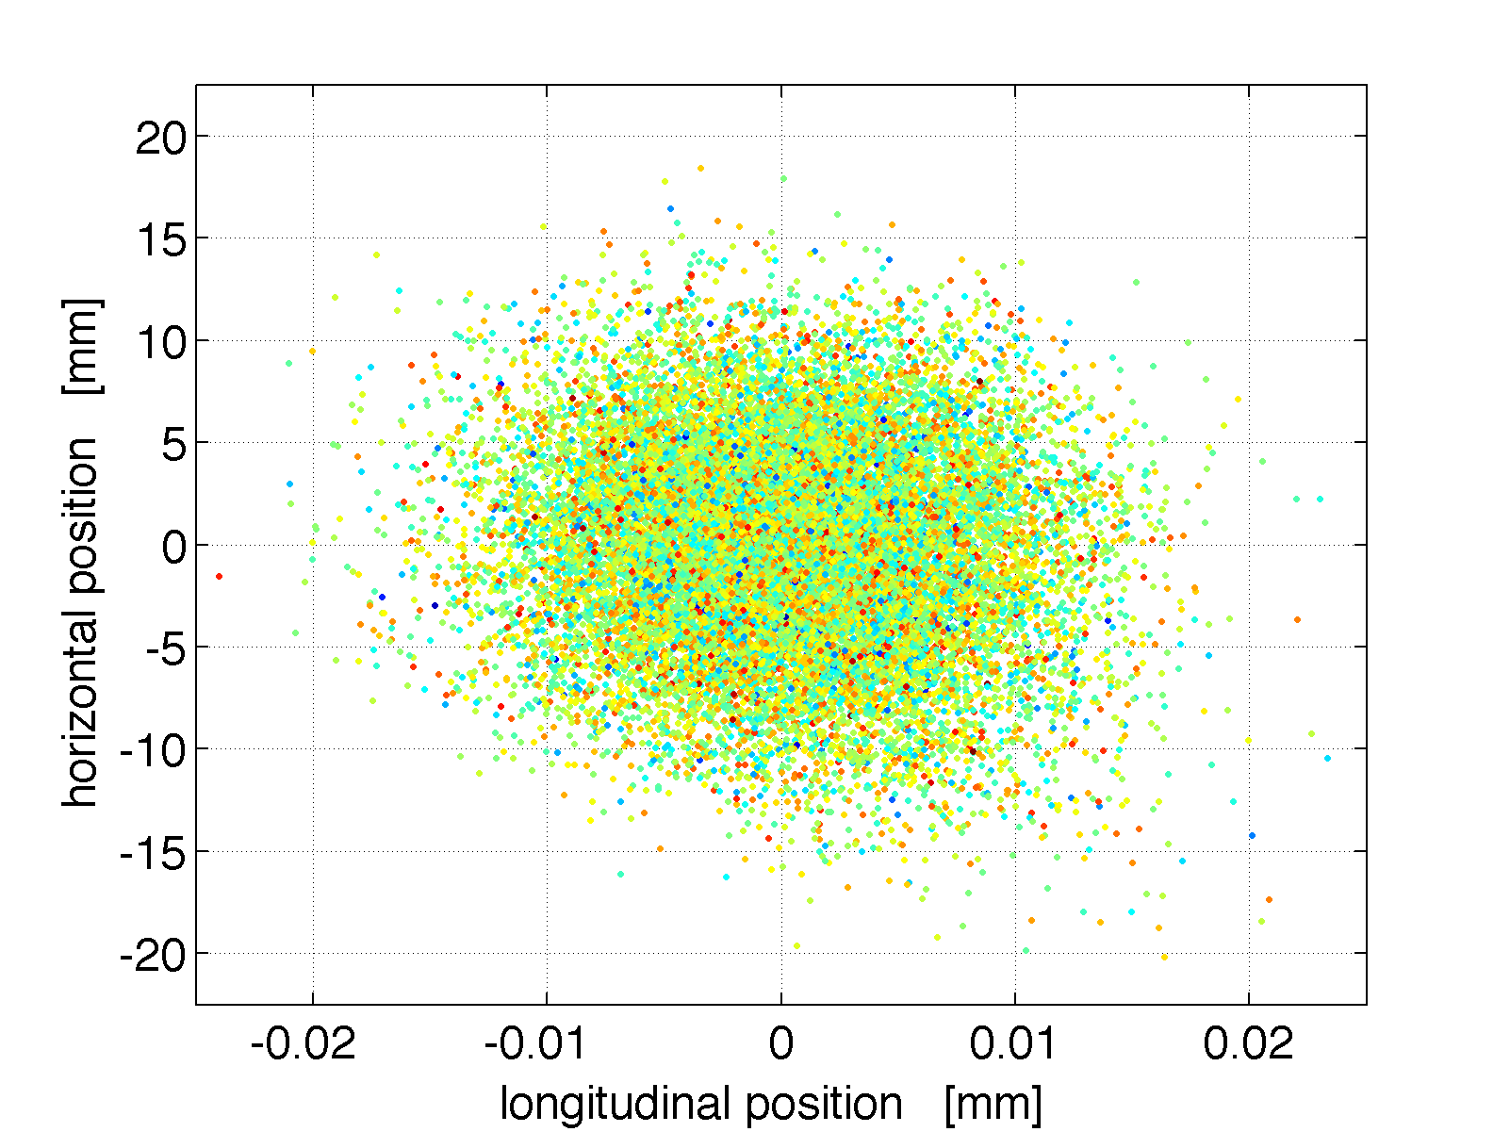
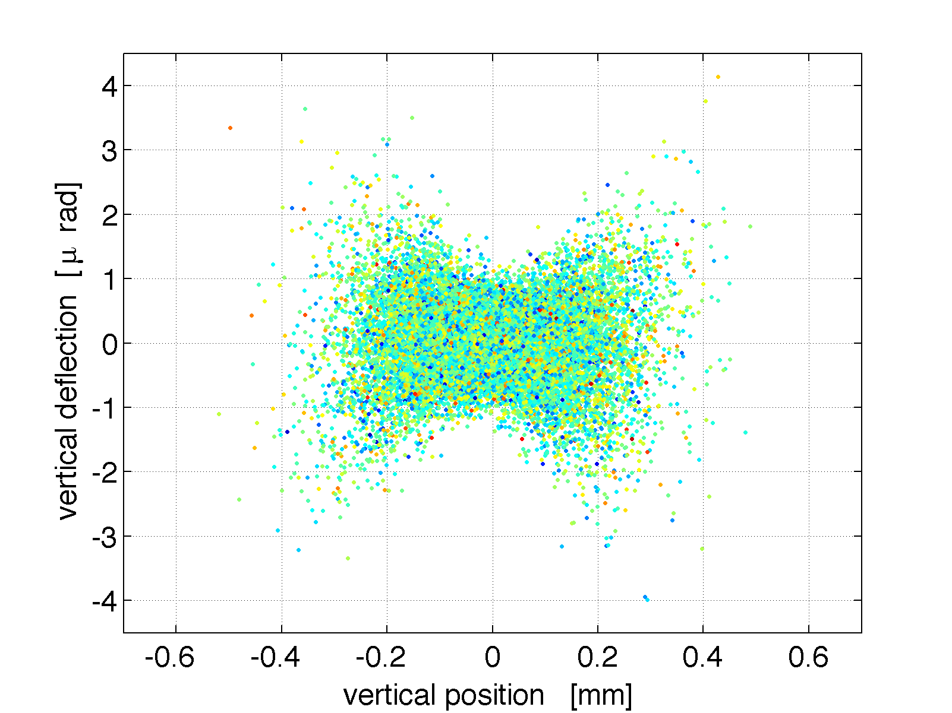
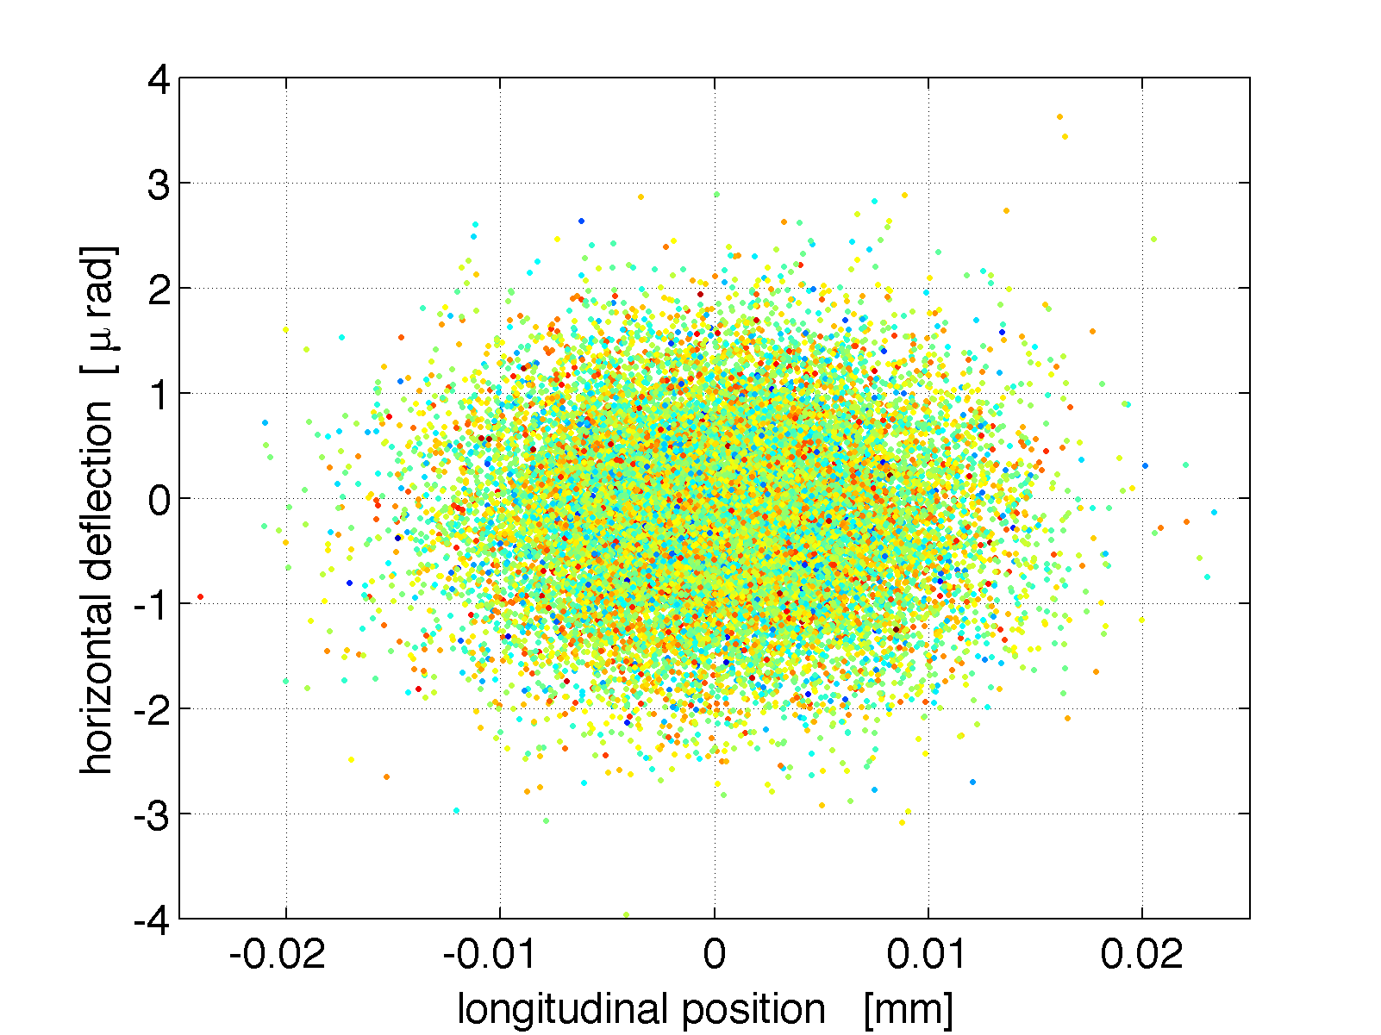
Linear Compressor status
-7.34607E-01 9.98690E-01 0.00000E+00 0.00000E+00 4.27991E-14 -1.29674E-13
-1.70389E-04 -1.36104E+00 0.00000E+00 0.00000E+00 -6.17189E-17 2.55012E-14
0.00000E+00 0.00000E+00 1.63360E+00 1.08742E+01 0.00000E+00 0.00000E+00
0.00000E+00 0.00000E+00 -3.99994E-04 6.09483E-01 0.00000E+00 0.00000E+00
-1.92249E-16 -1.32051E-15 0.00000E+00 0.00000E+00 -9.91818E-03 -2.45193E-04
-6.42281E-16 -5.25446E-12 0.00000E+00 0.00000E+00 2.38790E-01 -1.00819E+02
Notes:
7

Slide 8
Applications of Compressor
  Removal of additional correlations:
    Linear: “accidental chirps”, chicane over/under-compression
    Second order: RF curvature
    Third order: CSR, wakefield, space-charge effects *
    Nanometer-scale beam modulation *
  Longitudinal diagnostics
    3 microns (10 fsec) is mapped to ~50 microns after EEX1
    no energy dependence
    bunch length, slice charge density can be measured
      destructive: wire scanner, screen
      non-destructive: ODRI imaging
7.81019E-17 -5.89181E-02 0.00000E+00 0.00000E+00 1.69969E+01 1.21245E-17
1.21411E-30 -3.05311E-16 0.00000E+00 0.00000E+00 -8.88178E-16 5.88341E-02
0.00000E+00 0.00000E+00 2.00000E+00 7.17184E+00 0.00000E+00 0.00000E+00
0.00000E+00 0.00000E+00 6.21854E-01 2.72992E+00 0.00000E+00 0.00000E+00
4.16339E-02 5.88278E-02 0.00000E+00 0.00000E+00 0.00000E+00 -1.44319E-04
-6.36790E-14 2.40189E+01 0.00000E+00 0.00000E+00 0.00000E+00 1.11022E-16
Notes:
8

Slide 9
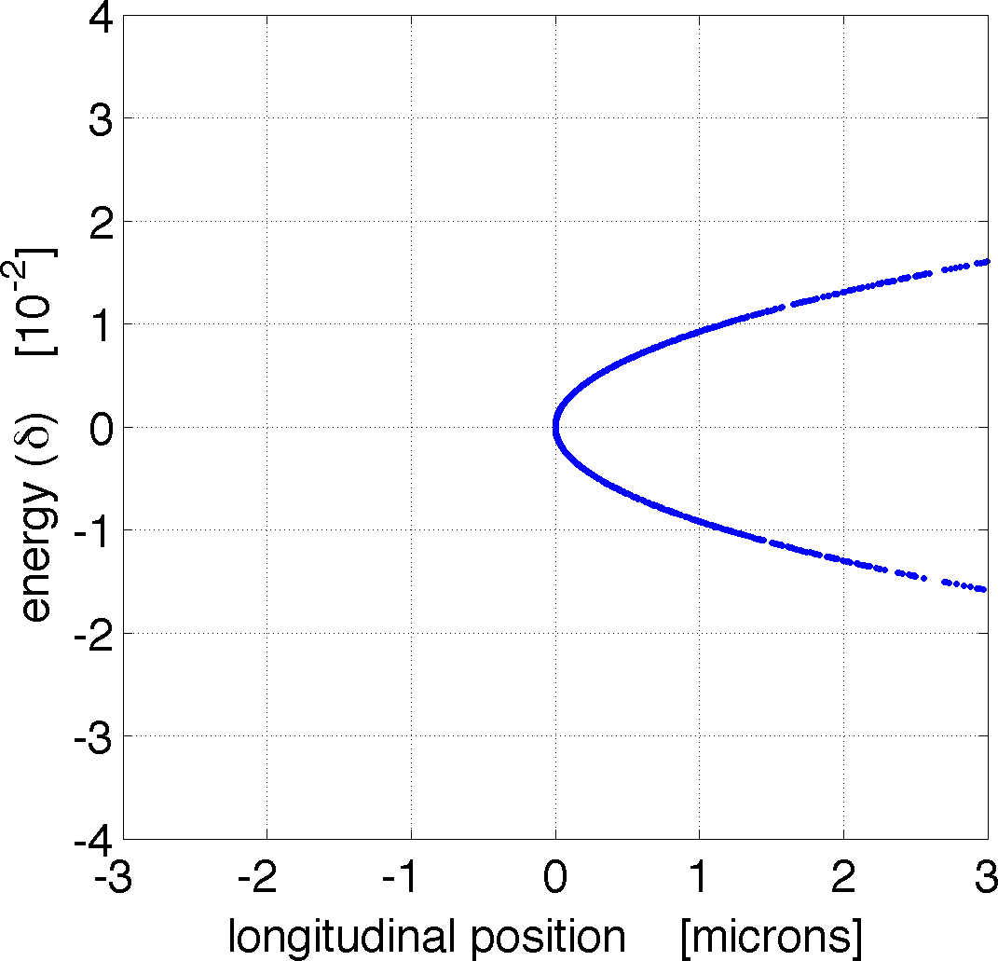
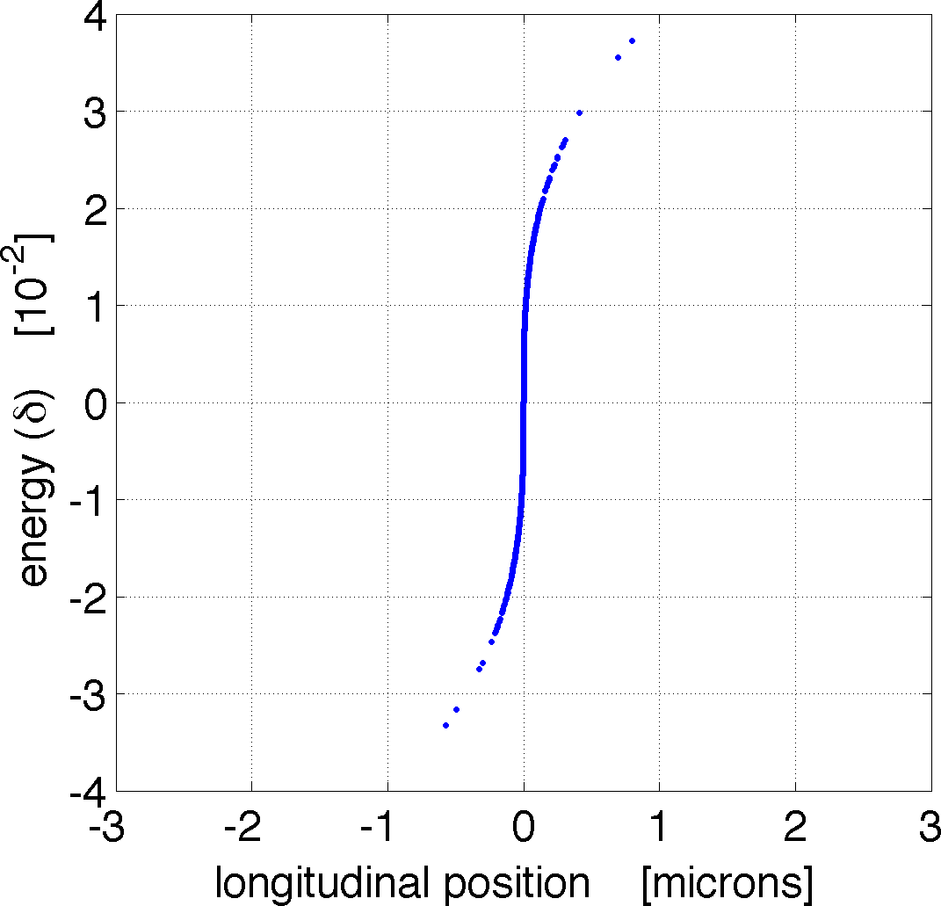
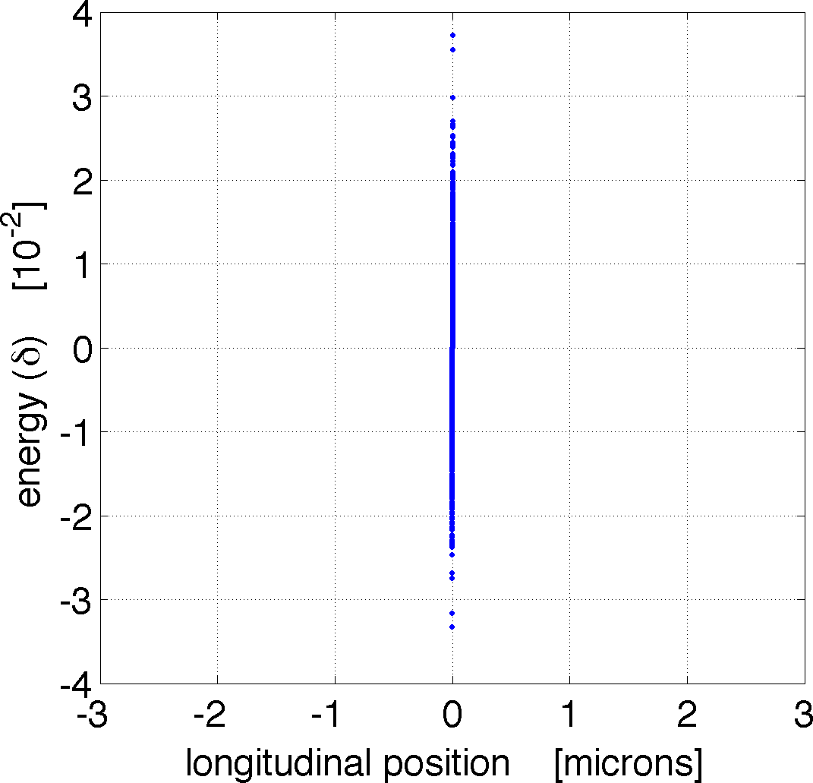
Applications: Nanometer modulation
  A zero-emittance beam, with 10e-5 energy spread, offers 17-nm longitudinal resolution “out of the box.”
  With sextupole and octopole correctors, that resolution improves to less than 1 nm.
  However, finite beam size (x,y) quickly destroys this resolution.
  Optimization of the longitudinal resolution is being actively pursued, with a goal to preserve nanometer-scale modulations and bunching.
Notes:
9

Slide 10
Applications: “Real beam”
A
B
D
Final longitudinal phase space
(at 12 GeV)
e_{x}= 0.15 mm s_{x}= 386 mm
e_{z}= 92.6 mm s_{z}= 400 mm
(3-psec FWHM)
e_{x}= 47.8 mm s_{x}= 5060 mm
e_{z}= 0.155 mm s_{z}= 25.2 mm
e_{x}= 0.170 mm s_{x}= 318 mm
e_{z}= 47.8 mm s_{z}= 4.33 mm
Notes:
10

Slide 11
Summary
  EEX-based compression techniques offer unique capabilities to a FEL-based beamline.
  They do not need an energy chirp to compress, yet can be tunable through a focusing telescope without changing any other parameters.
  Linearization of EEXs take a bit of optimization, but can preserve 0.1-micron transverse emittances.
  Longitudinal correlations, of any order, can be remedied through the use of nonlinear optics between the EEXs.
  Slice-based diagnostics are suddenly available, through the clean transfer of z-information into x.
  Compression is expected to preserve nanometer-scale resolution, allowing a seeded beam to be compressed to hard X-ray-level wavelengths.
Notes:
11

Slide 12
Notes:
12

